Slide 1
CLIENT APP
NETWORK SERVER
INPUT IMAGE SENT TO NETWORK SERVER
INPUT IMAGE
FACIAL RECOGNITION
MAPPED CORRESPONDING BLOCK PASSKEY
BLOCK DATA HOLDING THE INFO
PASSKEY SENT BACK FOR USER TO ACCESS THE BLOCK

Slide 2
CLIENT 1
CLIENT 2
HASH CODE LINK
BLOCK 2
BLOCK 1
NETWORK MANAGER
SMART CONTRACT
FACIAL RECOGNITION SOFTWARE
FACES DATABASE
HASH CODE LINK
SENDING OF FACE IMAGES
SENDING OF FACE IMAGES
SENDING OF PASSKEYS BACK TO CLIENTS
MAPPING TO PASSKEYS
HASH CODE LINK
BLOCK 3
BLOCK 4
CLIENT 4
CLIENT 3

Slide 3
CLIENT 1
CLIENT 2
CLIENT 3
AADHAR VERIFICATION
DATA
DATA
DATA
HASH 0
HASH 1
HASH 2
HASH 1
HASH 2
HASH 3
DETAILS
MAPPINGS
PASSKEY
PASSKEY
PASSKEY
FACE IMAGES
IMAGES 1
IMAGES 2
IMAGES 3
SMART CONTRACT

Slide 4
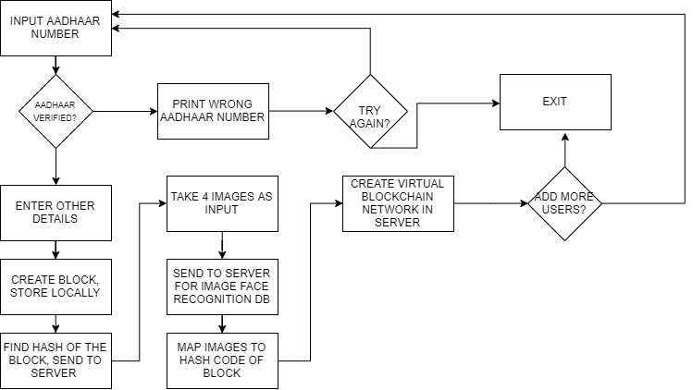
YES
NO
NO
YES
NO
YES

